Slide 1
A Perspective Analysis of a Planar Quadrotor
Md Rakibul Ahasan
Sanita Haque

Slide 2



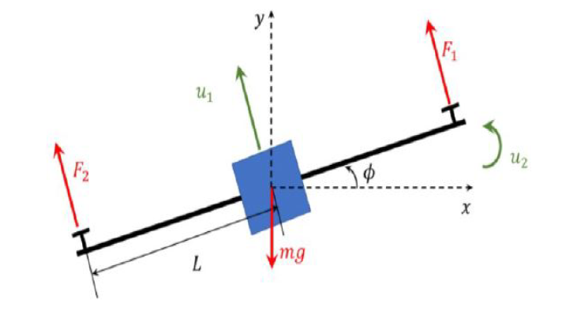


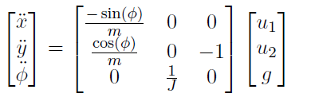
System details and Basic Properties
Fig: A Simple Planar Quadrotor.

Slide 3


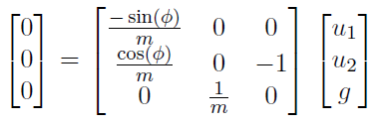
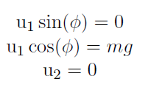

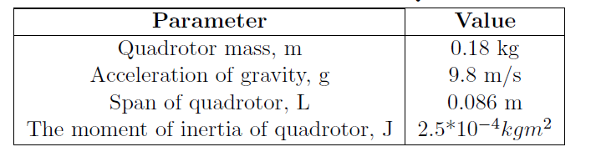
Equilibrium Point Determination
System Constant Parameter

Slide 4






Linearization

Slide 5
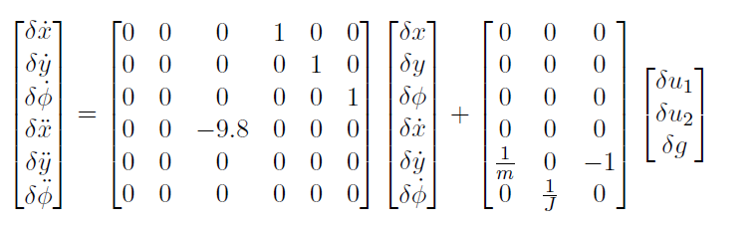
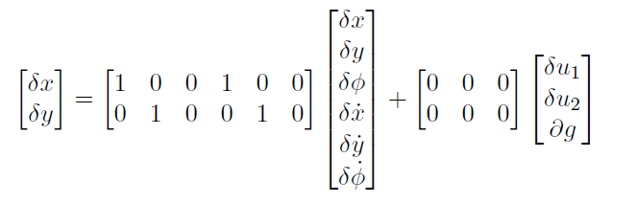
State Space Realization

Slide 6
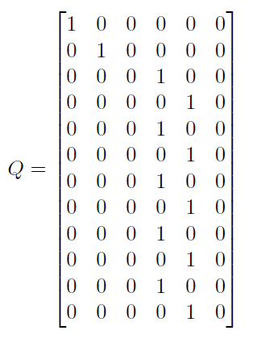
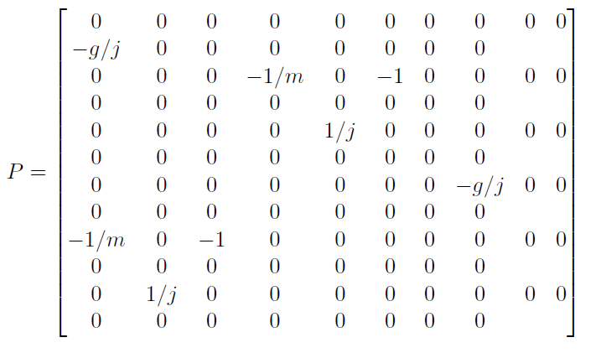
Controllability and Observability

Slide 7

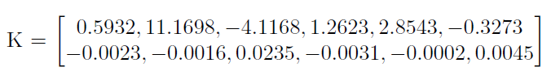
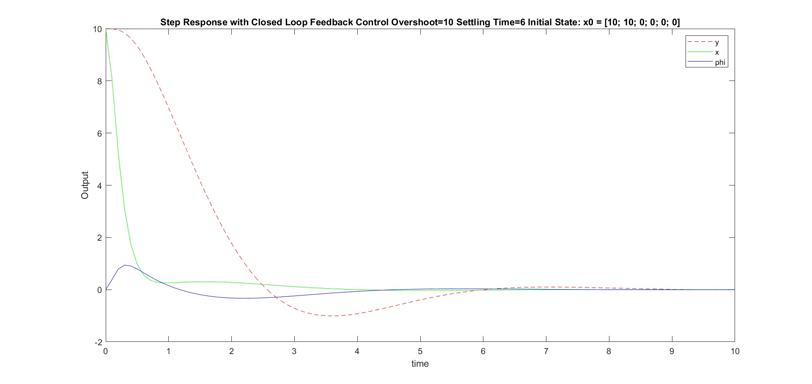
Controller Design-Controllability to the Origin Using Feedback Controller

Slide 8
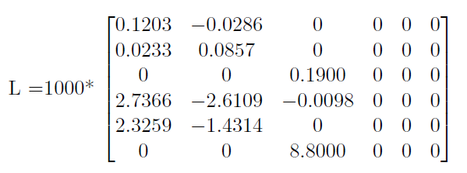

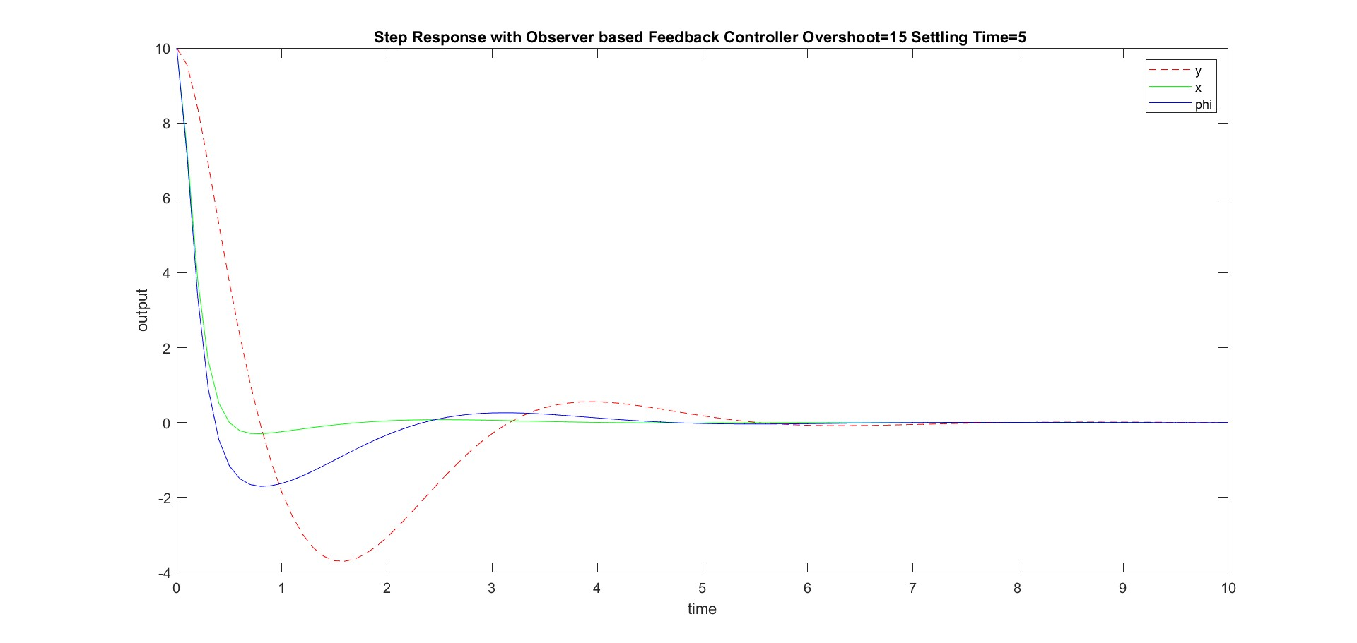
Controller Design-Observer based Feedback Controller

Slide 9


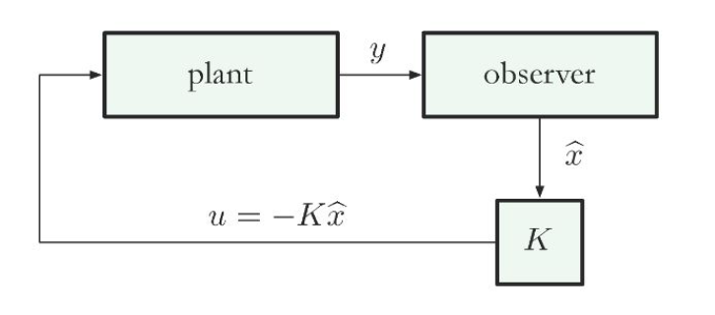




Controller Design: State space and observer feedback controller for non linear dynamics

Slide 10
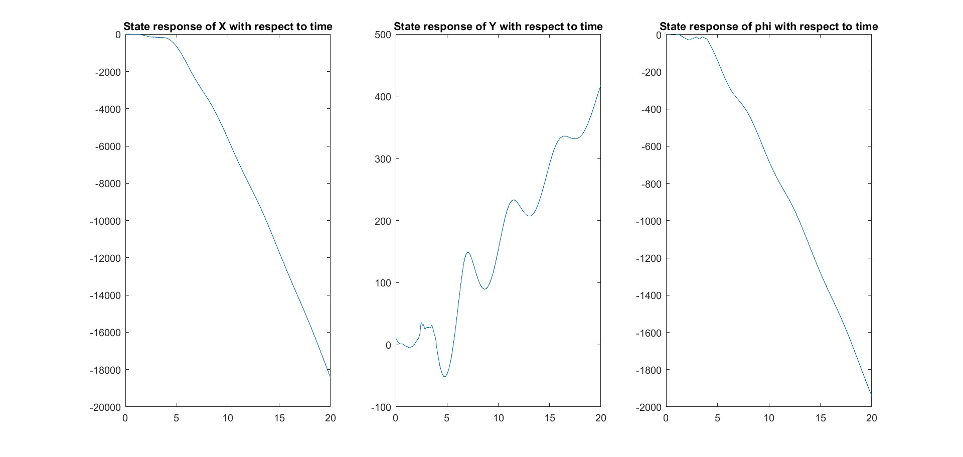
System state response
utilde = [0; 0], stilde = [0; 0; 0; 0; 0; 0] and initial state = [10; 10; 0; 0; 0; 0; 10; 10; 0; 0; 0; 0]

Slide 11
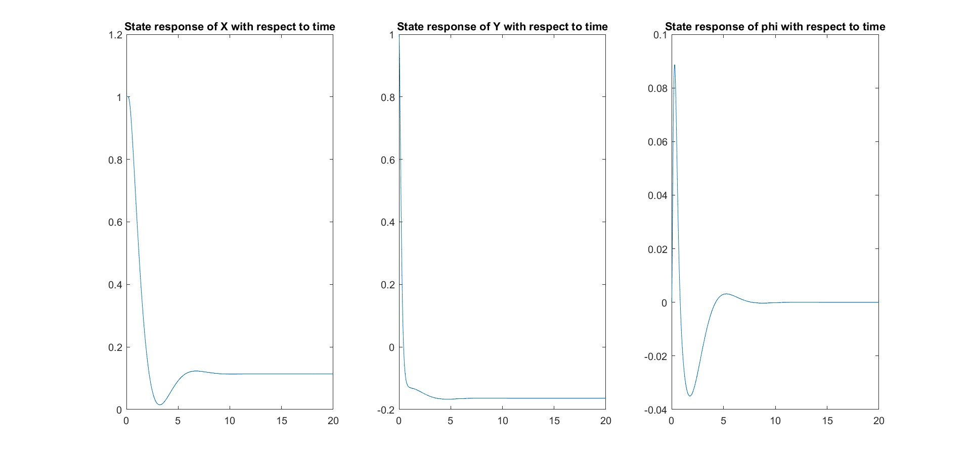
System state response cont
utilde = [0; 0], stilde = [0; 0; 0; 0; 0; 0] and initial state = [1; 1; 0; 0; 0; 0; 1; 0; 0; 0; 0; 0]

Slide 12
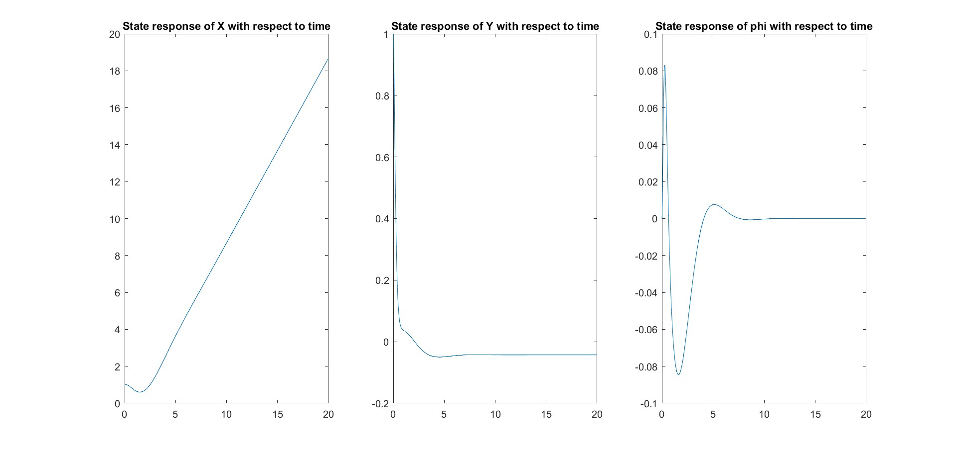
System state response cont
utilde = [mg; 0], stilde = [t; 0; 0; 0; 0; 0] and initial state = [1; 1; 0; 0; 0; 0; 1; 0; 0; 0; 0; 0]

Slide 13
What We Learn
We deduced state space feedback and observer based feedback controller for a linear state.However, that is proven wrong as quadrotor itself is a non-linear system.
We also build a PD controller for the demonstration and observe how a non-linear system can be \\
Finally we conclude by designing a controller which consider both the state space and observer feedback and we found our desired state by taking an iterative approach.

